Slide 1

Mini Project Final Presentation On Stock Market Prediction using Machine Learning
21R21A6615 – G HARISHWAR,
21R21A6608 - C ACHAL,
21R21A6657– PAVAN ADITYA,
21R21A6618 – G ANKESH
Under the Guidance of
Mrs. SOWMYA
ASST. PROFESSOR
Department of Computer Science & Engineering-Artificial Intelligence and Machine Learning

Slide 2
Stock market prediction using Machine learning

Slide 3
ABSTRACT
Stock price prediction is an attempt to forecast the future value of an individual stock, a particular sector or the market, or the market as a whole.
In Stock Price Prediction, the aim is to predict the future value of the financial stocks of a company
The recent trend in stock market prediction technologies is the use of machine learning which makes predictions based on the values of current stock market indices by training on their previous values.
Machine learning itself employs different models to make prediction easier and authentic. Here we are using LSTM(Long Short Term Memory) based Machine learning to predict stock values.

Slide 4
INTRODUCTION
Stock Market is a place where shares of public listed companies are traded.
Stock Market predictors that use machine learning to figure what stocks are most profitable.
All the factors that affect the performance of a stock will be fed into the neural network with proper data filtering only then it will be trained in the network which could predict the stock momentum

Slide 5
Why do we offer this?
Long short term memory (LSTM) is a model that increases the memory of recurrent neural networks.
In RNNs, LSTMs are very widely used in Neural networks. Their effectiveness should be implemented to multiple sequence modelling problems in many application domains like video, NLP, geospatial, and time-series.
Time-series data is a series of data values gathered over time interims, allowing us to trace differences over time. Time-series data can trace progress over milliseconds, days, and years.

Slide 6
LITERATURE SURVEY
SNo. | Authors Name & Year of Publication | Title | Existing System | Limitations
1. | Dr Subba Rao Polamuri Kudipudi Srinivas A. Krishna Mohan | A Survey on Stock Market Prediction Using Machine Learning Techniques | Prediction of the Stock Market is a challenging task in predicting the stock prices in the future. Due to the fluctuating nature of the stock, the stock market is too difficult to predict. Stock prices are constantly changing every day. Estimating of the stock market has a high demand for stock customers. Applying all extracted rules at any time is a major challenge to estimate the future stock price with high accuracy. The latest prediction techniques adopted for the stock market such as Artificial Neural Network, Neuro-Fuzzy System, Time Series Linear Models (TSLM), Recurrent Neural Network (RNN) and their advantages and disadvantages are studied and analyzed in this framework work. This paper is about to discuss different techniques related to the prediction of the stock market. | Less accuracy

Slide 7
LITERATURE SURVEY
Sno. | Authors Name and year of publication | Title | Existing System | Limitations
2. | V. Kanade, Bhausaheb Devikar Published 30 January 2017 | Stock Market Prediction: Using Historical Data Analysis | The Stock market process is full of uncertainty and it’s affected by many factors. Hence the Stock market prediction is one of the important exertions in business and finance. There are two types of analysis possible for prediction, fundamental and technical. In this paper both fundamental and technical analysis are considered. fundamental analysis is done using social media data by applying sentiment analysis process. Social media data has high impact today than ever, it can helpful in predicting the trend of the stock market and Technical analysis is done using historical data of stock prices by applying machine learning algorithms | Couldn’t handle huge data sets

Slide 8
LITERATURE SURVEY
Sno. | Authors Name and year of publication | Title | Existing System | Limitations
3. | K. S. Loke Published in: 2017 International Conference on Computer and Drone Applications (IConDA) | Impact of financial ratios and technical analysis on stock price prediction using random forests | A stock movement prediction method is presented using quarterly financial ratio data from Hong Kong companies from the period, 2011-2014. We found that the accuracy of price movement prediction using Random Forest method over multiple quarters to be fairly weak. However we were able to predict with high accuracy in the last quarter of 2014 and not in other years. We attribute this not to the superiority of the method but to the non-stationary nature of the price signals. | Less accuracy rate

Slide 9
PROPOSED SYSTEM
In this proposed system, we focus on predicting the stock values using machine learning algorithms like LSTM (Long Short Term Memory). We proposed a system called “Stock Price prediction”. We predicted the stock market price using LSTM. In this proposed system, we are able to train a machine from the various data points from the previous years to make a future prediction. We took the stock values from the previous year stocks to train the model. We used many machine-learning libraries to solve the problem. The first one was the NumPy package, which was used to clean and manipulate the data, and get it ready for analysis.
The datasets we used from the previous year stocks were collected from Yahoo Finance, 80 % of data was used to train the machine and the rest 20% for testing data. The basic procedure of the supervised-learning model is to learn the patterns and relationships in the data from the trained set of data and then replicate them for the test-data. We used the python pandas library for data processing which combined different data sets into a data frame. The tuned up data-frame allowed us to prepare the data for feature production. The data-frame features were date and the closing-price for a specified day. We also quantified the accuracy by using the predictions for the test set and the actual values.

Slide 10

OBJECTIVES
In order to analyse the future value of the company stock or other assets traded on the stock exchange, one must make a prediction about the stock market.
The forthcoming price of a stock of the successful estimation is called the Yield significant profit. This helps you to invest wisely for making good profits.

Slide 11
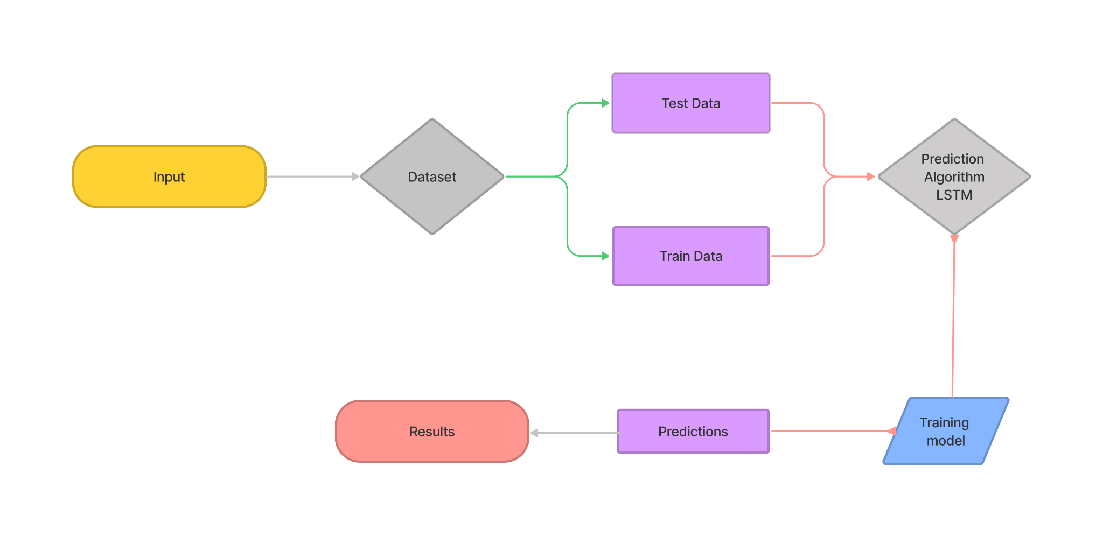
SYSTEM ARCHITECTURE

Slide 12
MODULE DESIGN
dATA SCRAPING
DATA PREPROCESSING
Model definition
Extracting data from websites that can provide with stock data.
Pre-processing the data so that it could be used for model making later.
Defining how the model needs to be shaped and what activations and other parameters are going to be taken.
Learning rate
Model fitting
training
Setting a custom rate for learning depending upon the time constraints or computing power constraints.
Fitting the model and optimizing it for the right vector shapes.
Training the model to find the results that we are looking for to make the investors and traders a lot of money.

Slide 13
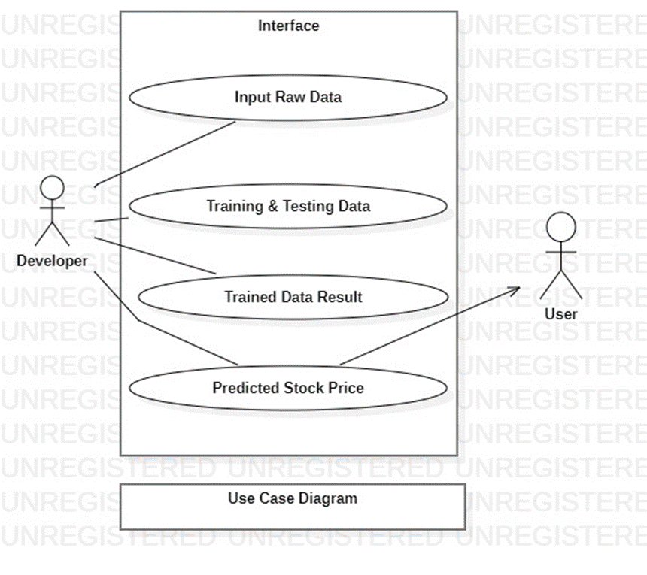
UML DIAGRAM

Slide 14
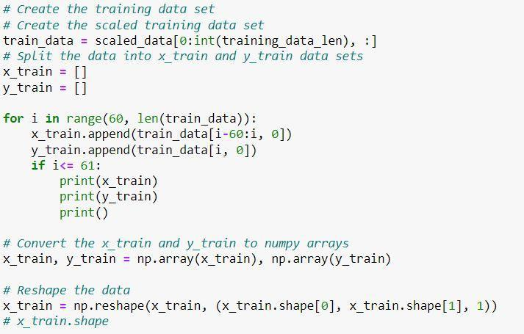
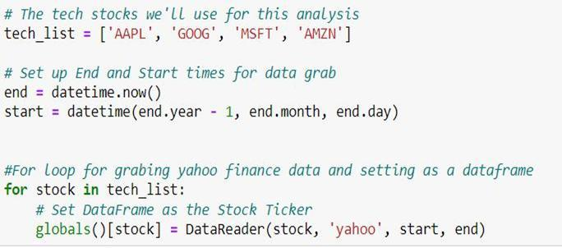
IMPLEMENTATION
DATA COLLECTION: TRAINING DATA:

Slide 15
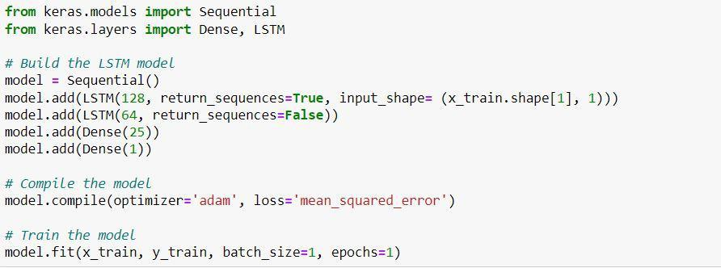
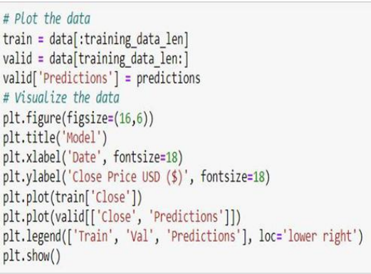
IMPLEMENTATION
BUILDING MODEL: PREDICTING VALUES:

Slide 16
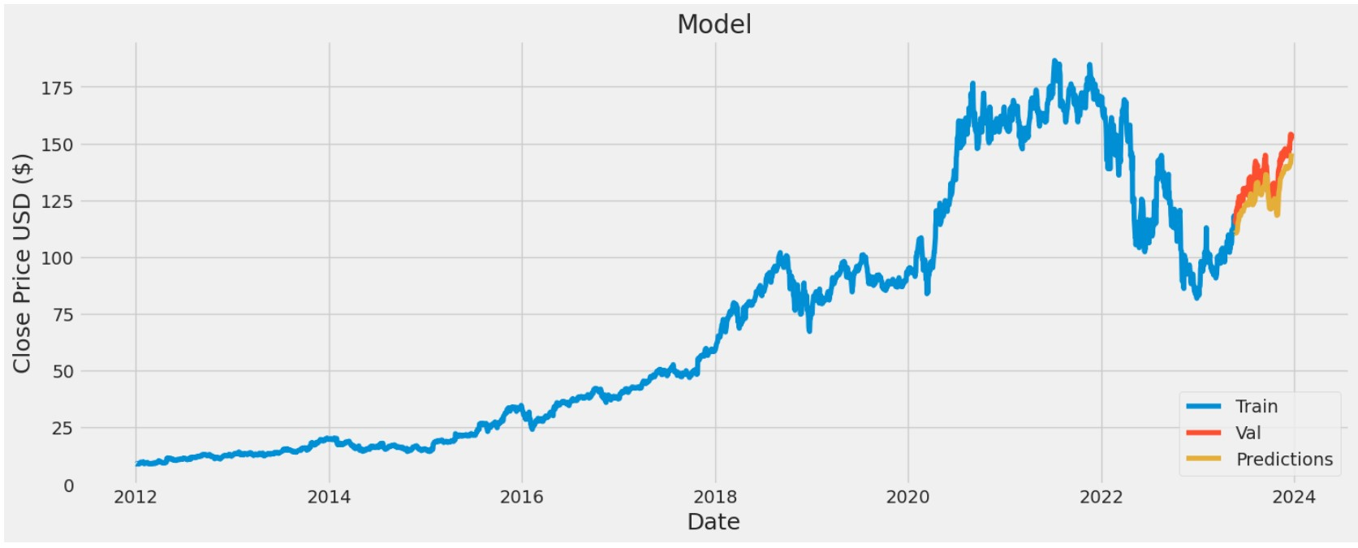
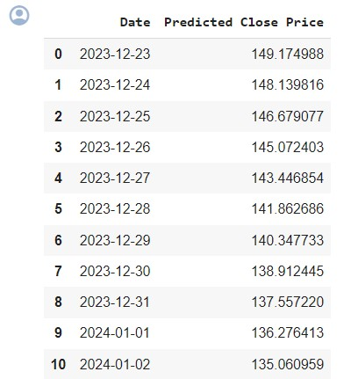
RESULT AND DISCUSSION

Slide 17
FUNCTIONAL REQUIREMENTS
As an input, the software will extract a dataset from the Yahoo Finance Library.
The software shall do pre-processing (like verifying for missing data values) on input for model training.
The software shall use LSTM ARCHITECTURE as the main component of the software.
It analyses the input data by predicting the CLOSING STOCK PRICE that is most likely to occur.

Slide 18
NON - FUNCTIONAL REQUIREMENTS
Reliability : Software must be able to handle the exceptions quickly and efficiently and must recover on time.
Usability : It must be easy for users to make the decision to invest.
Performance : It should be able to check the current stock market trends..
Input : The offered data sets must be connected to realistic trends.

Slide 19


ADVANTAGES
Accuracy
Effective
The stock prices will be more accurate.The accurate prediction of share price movement will lead to more profit investors can make.
This is achieved because the recurring module of the model has a combination of four layers interacting with each other.

Slide 20


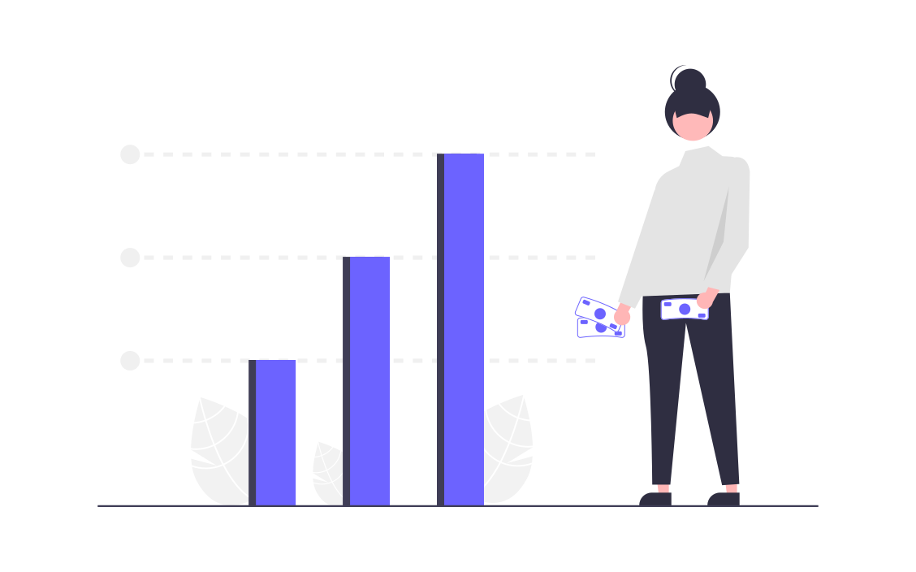
APPLICATIONS
Trade Execution
Strategy Implementation Algo.
Arbitrage Opportunities
Splitting of trades takes place using the prediction system so risks and losses can be potentially minimized
Real time market signals are observed and taken into consideration along with our proposed system.
Multiple markets could have same listed and different prices,movement predicted in one of them can be used as an arbitrage to benefit in other.

Slide 21
THEN VS NOW
THEN
NOW
Traditional method uses fundamental analysis, which looks stock’s past year performances.
Predicts the stock price using Long Short Term Memory(RNN) that used for predicting time series data.

Slide 22

CONCLUSION
Since the proposed model has greater accuracy, Using machine learning that leads to positive prediction of the stock price.
We have used datasets belonging to Google, Tesla, Apple, Amazon, Microsoft Stocks and achieved above 93% accuracy for these datasets
Therefore, this project leads to the conclusion that one can predict the stock market price with more accuracy using machine learning.

Slide 23
Thankyou!

